Slide 1
Sequence Models

Slide 2
NPTL- Deep Learning Course, Prof Mitesh Khapra
http://colah.github.io/posts/2015-08-Understanding-LSTMs/

Slide 3

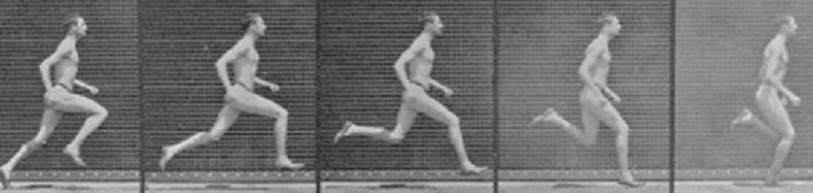


Sequence Models
Use cases
Speech Recognition |  | “Hi, How are you?”
Sentiment Analysis | “The movie made me sleep”
DNA Sequence Analysis | AGCCCCCTGTGAGGAAAAC | AGCCCCCTGTGAGGAAAAC
Machine Translation | How was your day | आपका दिन कैसा बीता
Video Activity Recognition |  | Running
NER | Iron man punched Hulk in Hulkbuster Armor | Iron man punched Hulk in Hulkbuster Armor
Music Generation

Slide 4
Sequence Models
Use cases
Why Sequence Models
How are you -> आप कैसे हैं
How
आप
are
कैसे
you
हैं
Fixed NN Size

Slide 5
Sequence Models
Use cases
Why Sequence Models
Did you eat food -> क्या आपने खाना खाया
Did
क्या
you
आपने
eat
खाना
food
खाया
Fixed NN Size

Slide 6
Sequence Models
Use cases
Why Sequence Models
On Sunday I ate Biryani- > रविवार को मैंने बिरयानी खाई
On
रविवार
Sunday
को
I
मैंने
ate
बिरयानी
Biryani
खाई
Fixed NN Size | Sequence is important

Slide 7
Sequence Models
Use cases
Why Sequence Models
On Sunday I ate Biryani- > रविवार को मैंने बिरयानी खाई
I ate Biryani on Sunday
On
रविवार
Sunday
को
I
मैंने
ate
बिरयानी
Biryani
खाई
Fixed NN Size | Sequence is important

Slide 8
Sequence Models
Use cases
Why Sequence Models
On Sunday I ate Biryani- > रविवार को मैंने बिरयानी खाई
I ate Biryani on Sunday
I
मैंने
ate
बिरयानी
Biryani
को
on
खाई
Sunday
रविवार
Fixed NN Size | Sequence is important/Parameters are not shared

Slide 9
Sequence Models
Use cases
Why Sequence Models
RNN
London is the capital of England
London is the capital of England
1 0 0 0 0 1
0
0
0
1
0
0
...
1
London
Y Lodon

Slide 10
Sequence Models
Use cases
Why Sequence Models
RNN
London is the capital of England
London is the capital of England
1 0 0 0 0 1
0
0
1
0
0
1
...
0
is
Y is
Y Lodon

Slide 11
Sequence Models
Use cases
Why Sequence Models
RNN
London is the capital of England
London is the capital of England
1 0 0 0 0 1
0
1
0
0
0
0
...
1
the
Y the
Y is

Slide 12
Sequence Models
Use cases
Why Sequence Models
RNN
London is the capital of England
London is the capital of England
1 0 0 0 0 1
1
0
0
0
0
1
...
1
capital
Y capital
Y the

Slide 13
Sequence Models
Use cases
Why Sequence Models
RNN
London is the capital of England
London is the capital of England
1 0 0 0 0 1
y^₁
y^₂
y^₃ y^₄ y^₅ y^₆
a ^{<1>}
a ^{<2>}
a ^{<3>}
a ^{<4>}
a ^{<5>}
a ^{<6>}
a ^{<0>}
London is the capital of England

Slide 14
Sequence Models
Use cases
Why Sequence Models
RNN
London is the capital of England
London is the capital of England
1 0 0 0 0 1
y
x

Slide 15
Sequence Models
Use cases
Why Sequence Models
RNN
y^₁
y^₂
y^₃ y^₄ y^₅ y^₆
a ^{<1>}
a ^{<2>}
a ^{<3>}
a ^{<4>}
a ^{<5>}
a ^{<6>}
a ^{<0>}
London is the capital of England

Slide 16
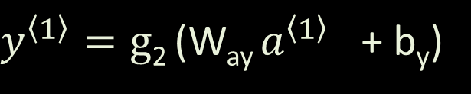
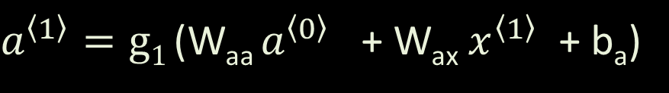
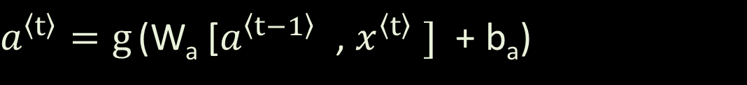
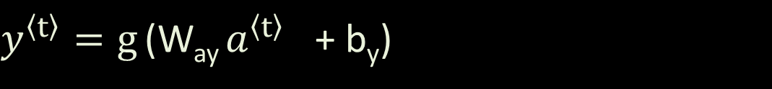
Sequence Models
Use cases
Why Sequence Models
RNN
y^₁
y^₂
y^₃ y^₄ y^₅ y^₆
a ^{<1>}
a ^{<2>}
a ^{<3>}
a ^{<4>}
a ^{<5>}
a ^{<6>}
a ^{<0>}
x1 x2 x3 x4 x5 x6
$a^{\left\langle 1\right\rangle }=g1$ (W_{aa} $a^{\left\langle 0\right\rangle }$ + W_{ax} $x^{\left\langle 1\right\rangle }$ + b_{a})
Tanh / Relu
$y^{\left\langle 1\right\rangle }=g$₂ (W_{ay} $a^{\left\langle 1\right\rangle }$ + b_{y})
sigmoid
$a^{\left\langle t\right\rangle }=g$ (W_{a} [$a^{\left\langle t−1\right\rangle }$ , $x^{\left\langle t\right\rangle } ]$ + b_{a})
$y^{\left\langle t\right\rangle }=g$ (W_{ay} $a^{\left\langle t\right\rangle }$ + b_{y})

Slide 17
Sequence Models
Use cases
Why Sequence Models
RNN
Training
X Y
London is the capital of England 1 0 0 0 0 1
Jamie went to US on vacation 1 0 0 1 0 0
Harry Potter and Hermoine went to Hogwarts 1 1 0 1 0 0 1

Slide 18
Sequence Models
Use cases
Why Sequence Models
RNN
London is the capital of England -> 1 0 0 0 0 1
loss₁ loss₂ loss₃ loss₄ loss₅ loss₆
y^ y^ y^ y^ y^ y^
Total loss = loss₁ + loss₂ + loss₃ +
loss₄ + loss₅ + loss₆
a ^{<0>}
a ^{<1>}
a ^{<2>}
a ^{<3>}
a ^{<4>}
a ^{<5>}
a ^{<6>}
London is the capital of England

Slide 19
Sequence Models
Use cases
Why Sequence Models
RNN
Types of RNN
Sentiment Analysis | “The movie made me sleep”
y^
a ^{<1>}
a ^{<2>}
a ^{<3>}
a ^{<4>}
a ^{<5>}
a ^{<0>}
The movie made me sleep
Many-One

Slide 20
Sequence Models
Use cases
Why Sequence Models
RNN
Types of RNN
Sentence Generation
Music Generation
y^ ₁ y^ ₂ y^ ₃ y^ ₄ y^ ₅ y^ ₆
a ^{<1>}
a ^{<2>}
a ^{<3>}
a ^{<4>}
a ^{<5>}
a ^{<0>}
X
Many-One | One-Many

Slide 21
Sequence Models
Use cases
Why Sequence Models
RNN
Types of RNN
Machine Translation | How was your day | आपका दिन कैसा बीता
आपका दिन कैसा बीता
a ^{<0>}
a ^{<1>}
a ^{<2>}
a ^{<3>}
How was your day
Encoder Decoder
Did you eat food today - > Nīvu indu āhāravannu sēvisiddīrā?
X_{t} == Y_{t} or X_{t} != Y_{t}
Many-One | One-Many | Many-Many

Slide 22
Sequence Models
Use cases
Why Sequence Models
RNN
Types of RNN
Vanishing Gradients
w₁
w₂
w₆
w₃
Loss
w₄
w₇
w₅

Slide 23
Sequence Models
Use cases
Why Sequence Models
RNN
Types of RNN
Vanishing Gradients
w₁
w₂
w₆
w₃
Loss
w₄
w₇
w₅

Slide 24

Sequence Models
Use cases
Why Sequence Models
RNN
Types of RNN
Vanishing Gradients
w₁
$∂$(Loss) / $∂$w₆
w₂
w₆ = w₆ – (learningRate * gradient)
w₆
w₃
Loss
w₄
w₇
w₅

Slide 25

Sequence Models
Use cases
Why Sequence Models
RNN
Types of RNN
Vanishing Gradients
$∂$(Loss) / $∂$w₁ = ($∂$Loss / $∂w6$) * ($∂$w₆ / $∂$w₁ )
w₁
$∂$(Loss) / $∂$w₆
w₂
w₆
w₆ = w₆ – (learningRate * gradient)
w₃
Loss
w₄
w₇
w₅

Slide 26
Sequence Models
Use cases
Why Sequence Models
RNN
Types of RNN
Vanishing Gradients
$∂$(Loss) / $∂$w₁ = ($∂$Loss / $∂w6$) * ($∂$w₆ / $∂$w₁ )
gradient = d1 * d2
gradient = 0.067 * 0.038
gradient = 0.00245
gradient = d1 * d2
gradient = 781 * 632
gradient = 493592‬
Vanishing Gradient
Exploding Gradient

Slide 27
Sequence Models
Use cases
Why Sequence Models
RNN
Types of RNN
Vanishing Gradients
w₁
w₂
w₆
w₃
Loss
w₄
w₇
w₅

Slide 28
Sequence Models
Use cases
Why Sequence Models
RNN
Types of RNN
Vanishing Gradients
More prominent in Deep NN

Slide 29
Sequence Models
Use cases
Why Sequence Models
RNN
Types of RNN
Vanishing Gradients
More prominent in Deep NN

Slide 30
Sequence Models
Use cases
Why Sequence Models
RNN
Types of RNN
Vanishing Gradients
More prominent in Deep NN

Slide 31
Sequence Models
Use cases
Why Sequence Models
RNN
Types of RNN
Vanishing Gradients
More prominent in Deep NN

Slide 32
Sequence Models
Use cases
Why Sequence Models
RNN
Types of RNN
Vanishing Gradients
Vanishing Gradient Problem in RNN
Change Today, due to my current job situation, I need to take a loan
Change Last year, due to my current job situation, I had to take loan
I need …
a ^{<1>}
a ^{<2>}
a ^{<3>}
a ^{<x>}
a ^{<y>}
a ^{<0>}
…
Today due to …

Slide 33
Sequence Models
Use cases
Why Sequence Models
RNN
Types of RNN
Vanishing Gradients
Vanishing Gradient Problem in RNN
Change Today, due to my current job situation, I need to take a loan
I need …
a ^{<3>}
a ^{<1>}
a ^{<2>}
Memory
a ^{<y>}
a ^{<0>}
…
a ^{<x>}
Today due to …
Change Last year, due to my current job situation, I had to take loan

Slide 34
Sequence Models
Use cases
Why Sequence Models
RNN
Types of RNN
Vanishing Gradients
LSTM
Long Short Term Memory

Slide 35
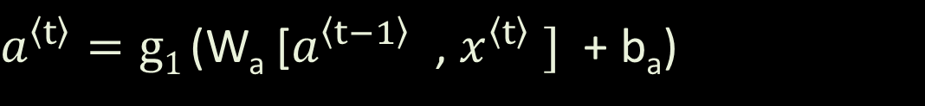
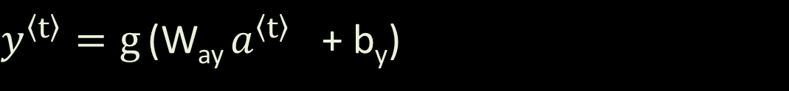
Sequence Models
Use cases
Why Sequence Models
RNN
Types of RNN
Vanishing Gradients
LSTM
Long Short Term Memory
Memory is a vector
y^₁
y^₂
y^₃ y^₄ y^₅ y^₆
c
c
c
c
c
c
c
a ^{<1>}
a ^{<2>}
a ^{<3>}
a ^{<4>}
a ^{<5>}
a ^{<6>}
a ^{<0>}
x1 x2 x3 x4 x5 x6
$a^{\left\langle t\right\rangle }=g1$ (W_{a} [$a^{\left\langle t−1\right\rangle }$ , $x^{\left\langle t\right\rangle } ]$ + b_{a})
Tanh
$y^{\left\langle t\right\rangle }=g$ (W_{ay} $a^{\left\langle t\right\rangle }$ + b_{y})

Slide 36
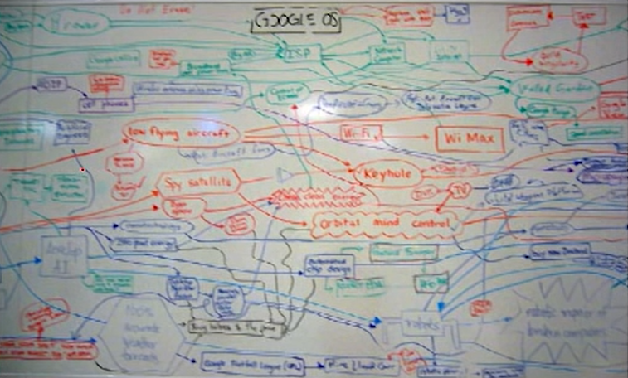
Sequence Models
Use cases
Why Sequence Models
RNN
Types of RNN
Vanishing Gradients
LSTM
Long Short Term Memory
Memory is Finite
White Board Analogy

Slide 37
Sequence Models
Use cases
Why Sequence Models
RNN
Types of RNN
Vanishing Gradients
LSTM
Long Short Term Memory
Given: a =1, b=3, c=5,d=11
Compute: ac(bd+a)+ad
Board can only have 3 statement at a time
1 . ac
2. bd
3. bd + a
4. ac(bd+a)
5. ad
6. ac(bd+a)+ad
ac = 5
bd = 33
bd+a = 34

Slide 38
Sequence Models
Use cases
Why Sequence Models
RNN
Types of RNN
Vanishing Gradients
LSTM
Long Short Term Memory
Given: a =1, b=3, c=5,d=11
Compute: ac(bd+a)+ad
Board can only have 3 statement at a time
1 . ac
2. bd
3. bd + a
4. ac(bd+a)
5. ad
6. ac(bd+a)+ad
ac = 5
ac(bd+a) = 170
bd = 33
bd+a = 34

Slide 39
Sequence Models
Use cases
Why Sequence Models
RNN
Types of RNN
Vanishing Gradients
LSTM
Long Short Term Memory
Given: a =1, b=3, c=5,d=11
Compute: ac(bd+a)+ad
Board can only have 3 statement at a time
1 . ac
2. bd
3. bd + a
4. ac(bd+a)
5. ad
6. ac(bd+a)+ad
ac = 5
ac(bd+a) = 170
bd = 33
bd+a = 34

Slide 40
Sequence Models
Use cases
Why Sequence Models
RNN
Types of RNN
Vanishing Gradients
LSTM
Long Short Term Memory
Memory is a vector
y^₁
y^₂
y^₃ y^₄ y^₅ y^₆
c
c
c
c
c
c
c
a ^{<1>}
a ^{<2>}
a ^{<3>}
a ^{<4>}
a ^{<5>}
a ^{<6>}
a ^{<0>}
x1 x2 x3 x4 x5 x6
$a^{\left\langle t\right\rangle }=g1$ (W_{a} [$a^{\left\langle t−1\right\rangle }$ , $x^{\left\langle t\right\rangle } ]$ + b_{a})
$y^{\left\langle t\right\rangle }=g$ (W_{ay} $a^{\left\langle t\right\rangle }$ + b_{y})

Slide 41
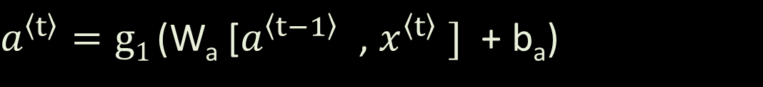
Sequence Models
Use cases
Why Sequence Models
RNN
Types of RNN
Vanishing Gradients
LSTM
Long Short Term Memory
c^{<t-1>}
c^{<t>}
a<t-1>
a<t>
$a^{\left\langle t\right\rangle }=g1$ (W_{a} [$a^{\left\langle t−1\right\rangle }$ , $x^{\left\langle t\right\rangle } ]$ + b_{a})
Tanh

Slide 42



Sequence Models
Use cases
Why Sequence Models
RNN
Types of RNN
Vanishing Gradients
LSTM
Long Short Term Memory
Forget Gate
c^{<t-1>}
c^{<t>}
sig
a^{<t-1>}
a^{<t>}
x^{<t>}
1
.9
7
6
2
1
5
1
1
0
.2
0
1
1
1
1
1
0
.14
0
1
1
1
1
$ft=σ$ (W_{t} [$a^{\left\langle t−1\right\rangle }$ , $x^{\left\langle t\right\rangle } ]$ + b_{t})
c^{<t-1>}
Forget Gate

Slide 43




Sequence Models
Use cases
Why Sequence Models
RNN
Types of RNN
Vanishing Gradients
LSTM
Long Short Term Memory
Forget Gate
c^{<t-1>}
c^{<t>}
Input Gate
$$it$$
$$C\sim t$$
sig
sig
tanh
a^{<t-1>}
a^{<t>}
x^{<t>}
$it=σ$ (W_{i} [$a^{\left\langle t−1\right\rangle }$ , $x^{\left\langle t\right\rangle } ]$ + b_{i})
Sigmoid -> decides which values to be added
$C\sim t=tanh$ (W_{c} [$a^{\left\langle t−1\right\rangle }$ , $x^{\left\langle t\right\rangle } ]$ + b_{c})
tanh -> Create values of candidate values

Slide 44



Sequence Models
Use cases
Why Sequence Models
RNN
Types of RNN
Vanishing Gradients
LSTM
Long Short Term Memory
Forget Gate
c^{<t-1>}
c^{<t>}
Input Gate
$ft=σ$ (W_{t} [$a^{\left\langle t−1\right\rangle }$ , $x^{\left\langle t\right\rangle } ]$ + b^{t})
$$it$$
$$C\sim t$$
sig
sig
tanh
a^{<t-1>}
a^{<t>}
x^{<t>}
$it=σ$ (W_{i} [$a^{\left\langle t−1\right\rangle }$ , $x^{\left\langle t\right\rangle } ]$ + b_{i})
c^{<t>} = f^{t} * c^{<t-1>} + i_{t} * c^{~t}
^{c}$\sim t=tanh$ (W_{c} [$a^{\left\langle t−1\right\rangle }$ , $x^{\left\langle t\right\rangle } ]$ + b_{c})

Slide 45




Sequence Models
Use cases
Why Sequence Models
RNN
Types of RNN
Vanishing Gradients
LSTM
Long Short Term Memory
Forget Gate
c^{<t-1>}
c^{<t>}
Input Gate
$$tanh(ct)$$
tanh
Output Gate
sig
sig
tanh
sig
a^{<t-1>}
o$t$
a^{<t>}
x^{<t>}
o$t=σ$ (W_{o} [$a^{\left\langle t−1\right\rangle }$ , $x^{\left\langle t\right\rangle } ]$ + b₀)
a$t=ot ∗tanh(ct)$

Slide 46
Sequence Models
Use cases
Why Sequence Models
RNN
Types of RNN
Vanishing Gradients
LSTM
Long Short Term Memory
Forget Gate
c^{<t-1>}
c^{<t>}
Input Gate
tanh
Output Gate
sig
sig
tanh
sig
a^{<t-1>}
a^{<t>}
x^{<t>}
1. Memory
2. Forget Gate
3. Input Gate
4. Output Gate

Slide 47
Sequence Models
Use cases
Why Sequence Models
RNN
Types of RNN
Vanishing Gradients
LSTM
Long Short Term Memory
Many Variations
GRUs
Seq to Seq
Vect to Seq
Vect to Vect
Encoder Decoder
Attention Models

Slide 48
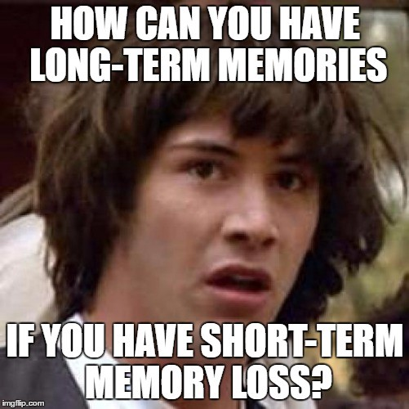
Thanks

Slide 49
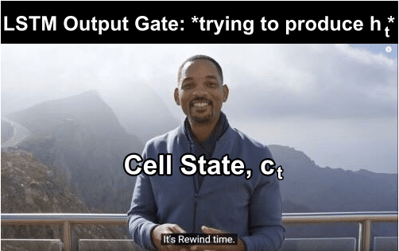

Thanks

Slide 50


